Slide 1
Chapter Five
Risk, Return, and the Historical Record

Slide 2
Chapter Overview
Interest rate determinants
Rates of return for different holding periods
Risk and risk premiums
Estimations of return and risk
Normal distribution
Deviation from normality and risk estimation
Historic returns on risky portfolios

Slide 3
Interest Rate Determinants
Supply
Households
Demand
Businesses
Government’s net demand
Federal Reserve actions

Slide 4
Real versus Nominal Interest Rates
Nominal interest rate:
Real interest rate:
Notes:
Nominal interest rate: Growth rate of your money
Real interest rate: Growth rate of your purchasing power

Slide 5
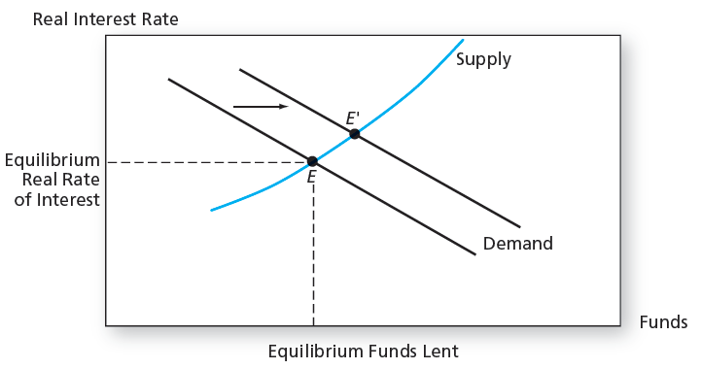
Determination of the Equilibrium Real Rate of Interest

Slide 6
Equilibrium Nominal Rate of Interest
As the inflation rate increases, investors will demand higher nominal rates of return
If E(i) denotes current expectations of inflation, then we get the Fisher Equation:

Slide 7
Taxes and the Real Interest Rate
Tax liabilities are based on nominal income
The after-tax real rate falls as the inflation rises

Slide 8
Taxes and the Real Interest Rate Example

Slide 9
Rates of Return for Different Holding Periods
Zero Coupon Bond:
Par = $100
Maturity = T
Price = P
Total risk free return

Slide 10
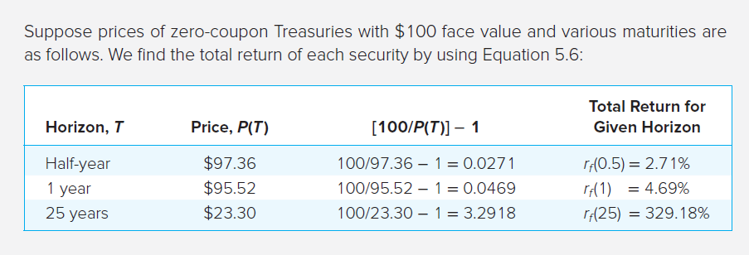
Annualized Rates of Return

Slide 11
Effective Annual Rate (EAR) and Annual Percentage Rate (APR)
Effective Annual Rate (EAR):
Annualized Percentage Rate (APR):
Notes:
EAR: Percentage increase in funds invested over a 1-year horizon
APR: Annualizing using simple interest

Slide 12
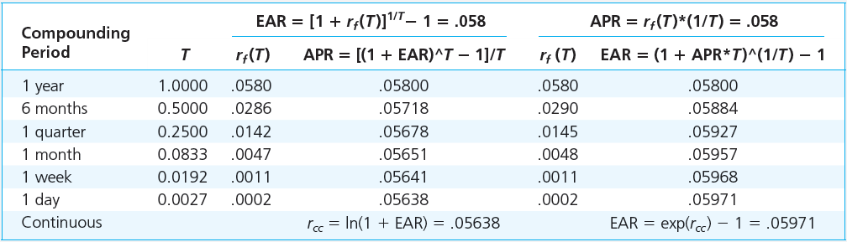
APR versus EAR

Slide 13
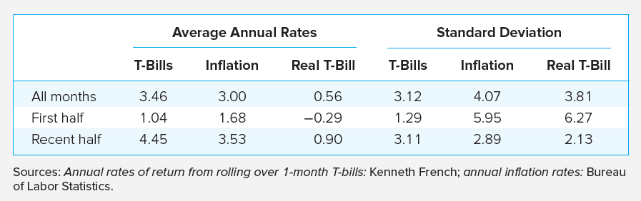
T-Bill Rates, Inflation Rates, and Real Rates, 1926-2015

Slide 14
Bills and Inflation, 1926-2015
Moderate i offsets most nominal gains on low-risk investments
$1 in T-bills from 1926–2015 grew to $20.25 but with a real value of only $1.55
Negative correlation between r_{real} and i → r_{nom} doesn’t fully compensate investors for increases in i.

Slide 15
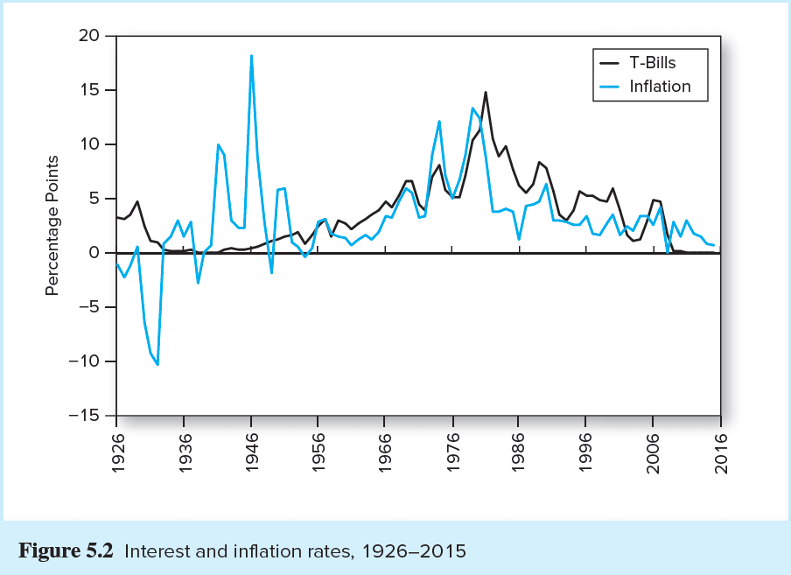
Interest Rates and Inflation, 1926-2015

Slide 16
Risk and Risk Premiums
Rates of return: Single period
HPR = Holding period return
P₀ = Beginning price
E(P₁) = Expected Ending price
E(D₁) = Expected Dividend during period one

Slide 17
Rates of Return: Single Period Example
Expected Ending Price = $110
Beginning Price = $100
Expected Dividend = $4
Holding Period Return
Capital Gains Yield
Dividend Yield

Slide 18
Expected Return and Standard Deviation (1 of 2)
Expected returns
p(s) = Probability of a state
r(s) = Return if a state occurs
s = State

Slide 19
Scenario Returns: Example
State Prob. of State r in State
Excellent .25 0.3100
Good .45 0.1400
Poor .25 -0.0675
Crash .05 -0.5200

Slide 20
Expected Return and Standard Deviation (2 of 2)
Variance (VAR):
Standard Deviation (STD):

Slide 21
Scenario VAR and STD: Example
Example VAR calculation:
Example STD calculation:

Slide 22
Time Series Analysis of Past Rates of Return
True means and variances are unobservable
Possible scenarios like the one in the examples are unknown
Means and variances must be estimated

Slide 23
Returns Using Arithmetic and Geometric Averaging
Arithmetic Average
Geometric (Time-Weighted) Average
Terminal value of the investment:
Geometric Average:

Slide 24
Estimating Variance and Standard Deviation
Estimated Variance
Expected value of squared deviations
Unbiased estimated standard deviation

Slide 25
The Reward-to-Volatility (Sharpe) Ratio
Excess Return
Risk Premium
Sharpe Ratio
Notes:
Excess Return: The difference in any particular period between the actual rate of return on a risky asset and the actual risk-free rate
Risk Premium: The difference between the expected HPR on a risky asset and the risk-free rate

Slide 26
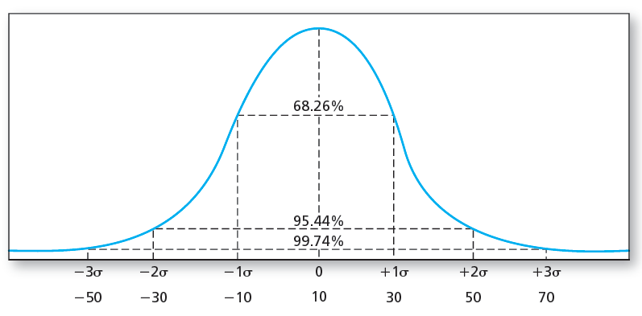
The Normal Distribution (1 of 2)
Mean = 10%, SD = 20%

Slide 27
The Normal Distribution (2 of 2)
Investment management is easier with normal returns:
Symmetric Returns → Standard deviation is a good measure of risk
Symmetric Returns → Portfolio returns will be as well
Only mean and standard deviation needed to estimate future scenarios
Pairwise correlation coefficients summarize the dependence of returns across securities

Slide 28
Normality and Risk Measures (1 of 3)
What if excess returns are not normally distributed?
STD is no longer a complete measure of risk
Skewness:
Kurtosis:
Sharpe ratio is not a complete measure of portfolio performance
Notes:
Skew: Ratio of the average cubed deviations from the sample average, also called the third moment
Kurtosis: The likelihood of extreme values on either side of the mean

Slide 29
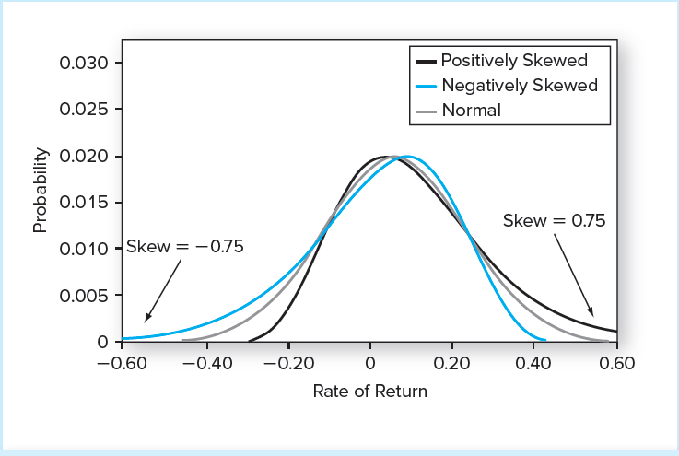
Normal and Skewed Distributions
Mean = 6%
STD = 17%

Slide 30
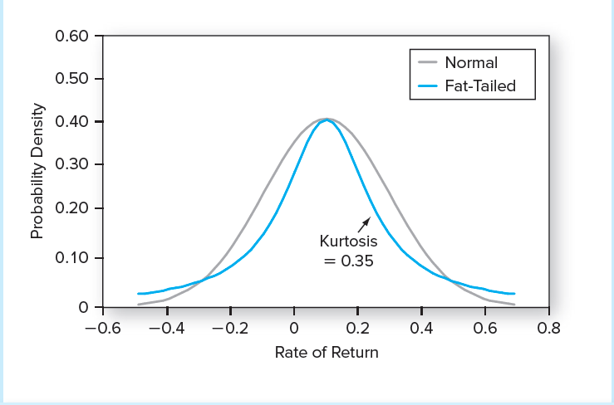
Normal and Fat-Tailed Distributions
Mean = 10%
STD = 20%

Slide 31
Normality and Risk Measures (2 of 3)
Value at Risk (VaR)
Expected Shortfall (ES)
Notes:
Value at Risk (VaR)
Loss corresponding to a very low percentile of the entire return distribution, such as the fifth or first percentile return
Expected Shortfall (ES)
Also called conditional tail expectation (CTE), focuses on the expected loss in the worst-case scenario (left tail of the distribution)
More conservative measure of downside risk than VaR

Slide 32
Normality and Risk Measures (3 of 3)
Lower Partial Standard Deviation (LPSD)
Similar to usual standard deviation
Uses only negative deviations from the risk-free return
Addresses the asymmetry in returns issue
Sortino Ratio
The ratio of average excess returns to LPSD
Notes:
Lower Partial Standard Deviation (LPSD)
Similar to usual standard deviation, but uses only negative deviations from the risk-free return, thus, addressing the asymmetry in returns issue
Sortino Ratio
The ratio of average excess returns to LPSD

Slide 33
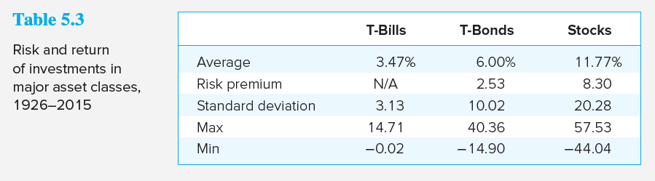
Historic Returns on Risky Portfolios (1 of 2)

Slide 34
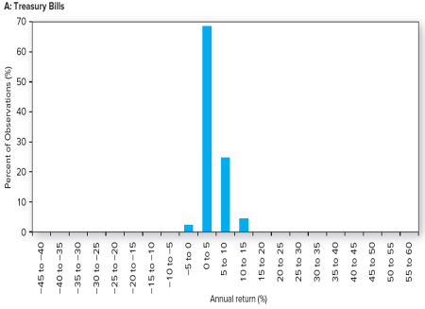
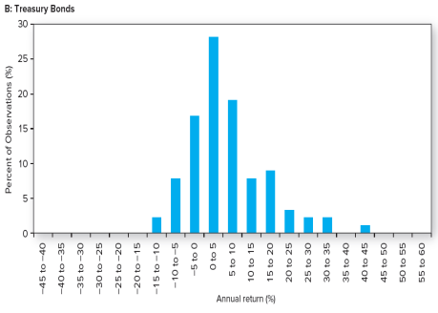
Historic Returns on Risky Portfolios: Treasury Bills and Bonds
Notes:
Think: Do these look normally distributed?
Note: You might wonder about the negative T-bill rates that show up in the frequency distribution above. T-bills did not make their debut until the 1940s. For earlier dates, commercial paper is used as the closest approximation to short-term risk-free rates. In a few instances they were issued slightly above par and thus yielded slightly negative rates.

Slide 35
Historic Returns on Risky Portfolios: Equity Markets (1 of 2)
The second half of the 20th century offered the highest average returns
Firm capitalization is highly skewed to the right: Many small but a few gigantic firms
Average realized returns have generally been higher for small stocks vs. large stocks

Slide 36
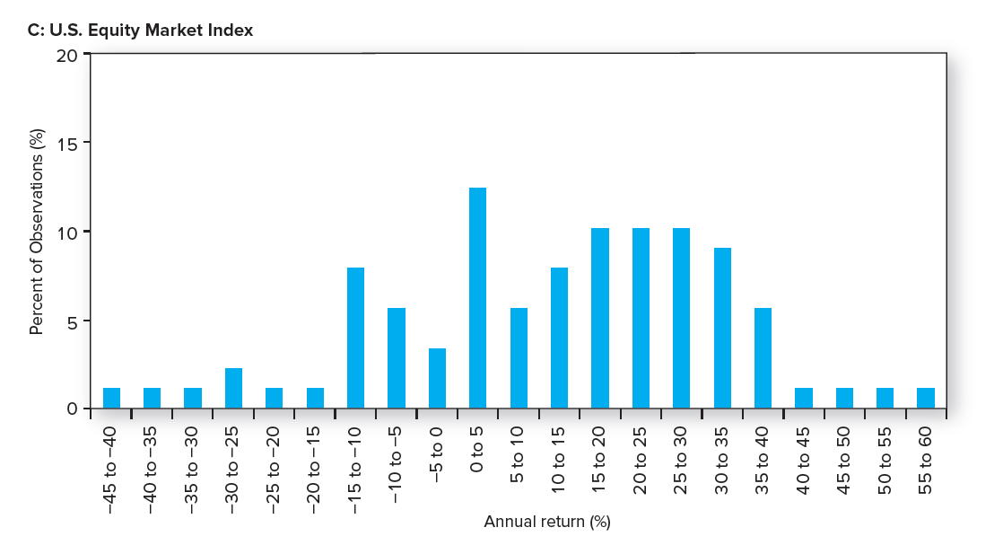
Historic Returns on Risky Portfolios: Equity Markets (2 of 2)
Notes:
Think: Does this look normally distributed?

Slide 37
Historic Returns on Risky Portfolios (2 of 2)
Normal distribution is generally a good approximation of returns
VaR indicates no greater tail risk than equivalent normal
ES ≤ 0.41 of monthly SD → no evidence against normality
However
Negative skew is present in some portfolios some of the time
Positive kurtosis is present in all portfolios all the time

Slide 38
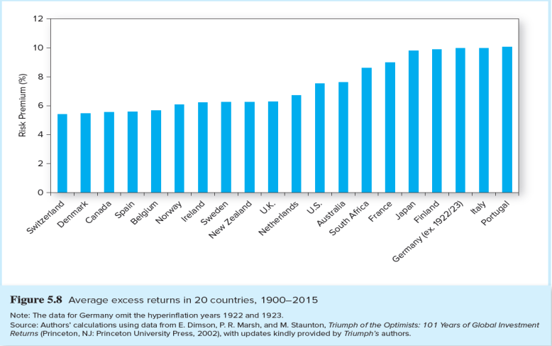
Average Excess Returns Around the World: 1900-2015

